Slide 1
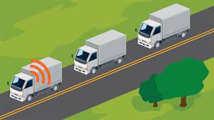
TRUCK PLATOONING SYSTEM
Team: SVSH
Supadma Kadabi
Vibhashree Hippargi
Sachin Kumar
Hamida Aliveya
Git: https://github.com/VibhaHippargi/DPSTruckPlatooning/tree/final

Slide 2



What is Platooning?
Leader truck
Truck platooning is the linking of two or more trucks in a convoy, using connectivity technology and automated driving support systems.

Slide 3
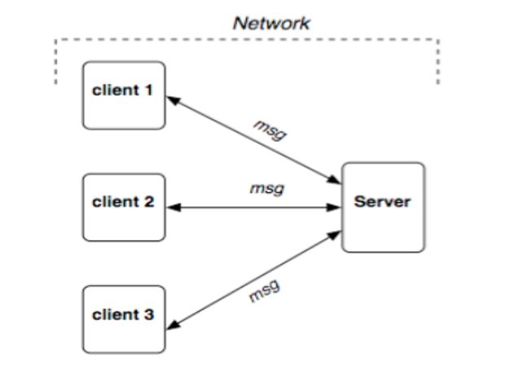
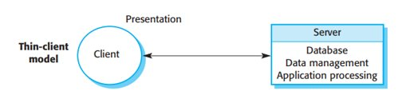
CLIENT – SERVER ARCH.
Client Server model Structure
Thin Client Server Model
Notes:
Distributed systems which communicate with each other over the network are usually addressed as Client-Server architecture model. The below figure shows the pictorial representation of a server that is connected to 3 clients through a network. They communicate with each other by exchanging messages (msg in the diagram).

Slide 4
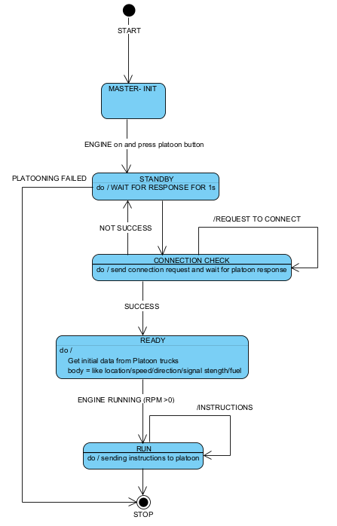
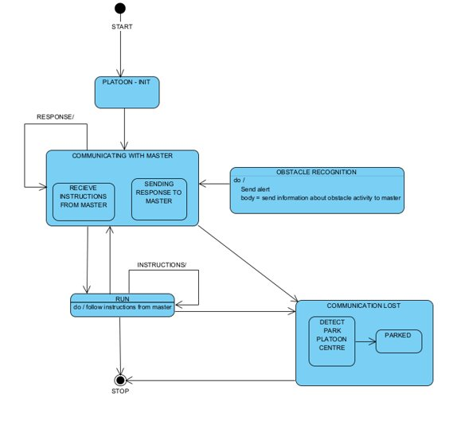
State Diagram
Leader truck
Platooned Trucks

Slide 5
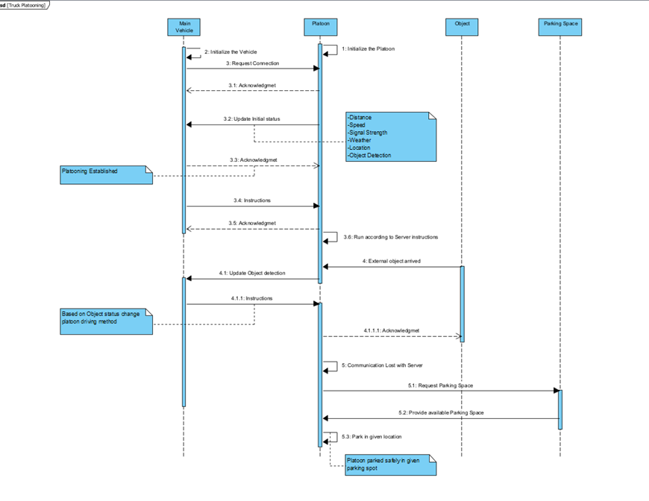
Sequence Diagram

Slide 6
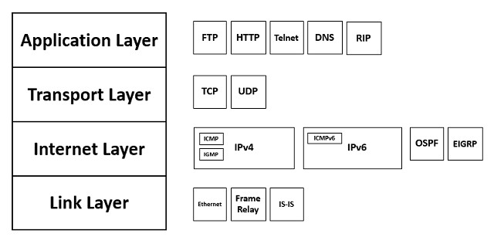
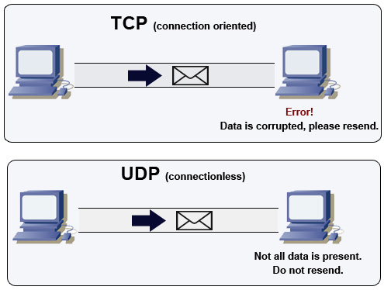
TCP/IP Model
A protocol is a set of rules that is to be followed for proper communication between the devices on a network. It ensures that communication is carried out in a consistent and predictable way. TCP/IP model is a conceptual framework that defines how the devices send and receive messages with each other over a network.

Slide 7
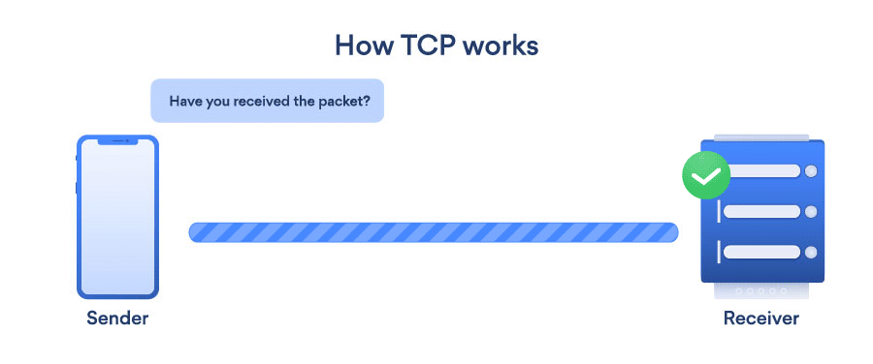
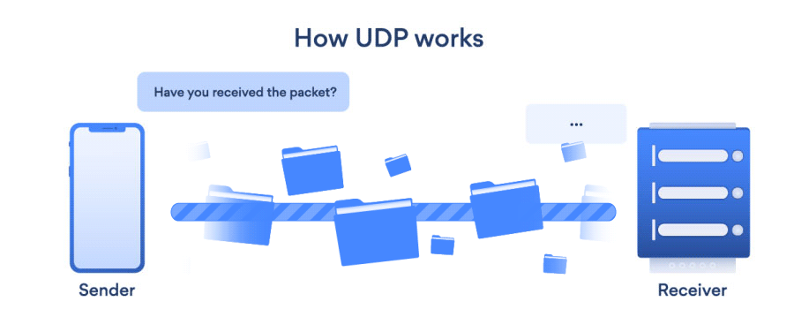
TCP and UDP
TCP -> Connection-oriented (Ack), reliable, re-transmission of lost packets
UDP -> Connectionless(No Ack), less reliable, data once lost are lost.
Source: https://www.infosectrain.com/blog/all-about-network-protocols/

Slide 8
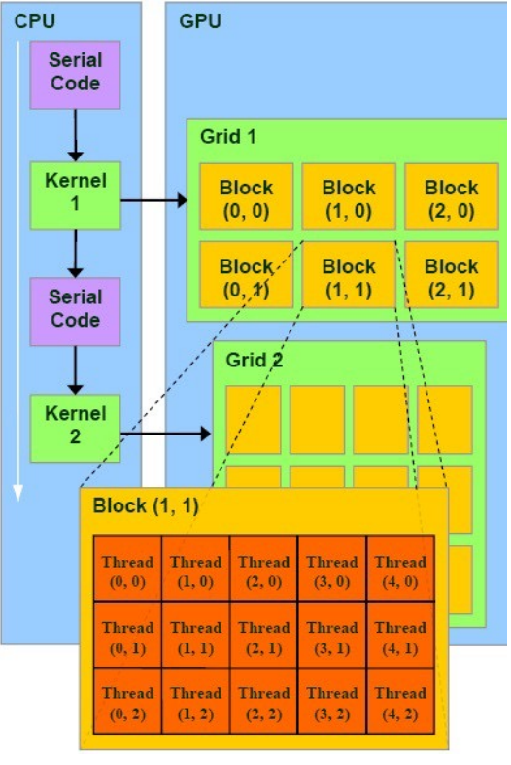
GPU Implementation
Graphical Processing Unit
Highly threaded co-processor with the Host (CPU)
Data Parallelism
Sections of the applications that are run on the GPU are Kernels
Grid is a collection of blocks (collection of threads)
that can execute in parallel
OpenCL (Open Computing language) – Cross-platform and Heterogenous computing
Portable across different hardware platforms
OpenCL is supported by major hardware vendors such as AMD, Intel, and NVIDIA

Slide 9
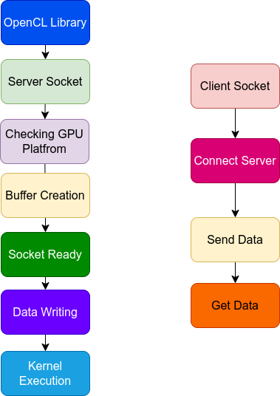
Topology

Slide 10
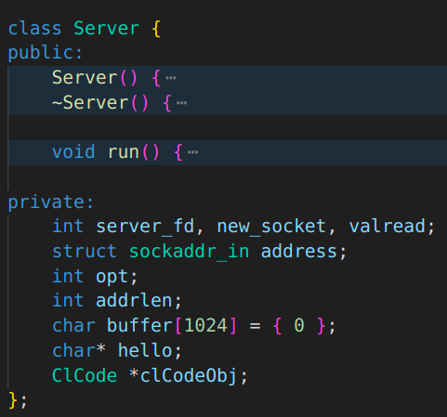
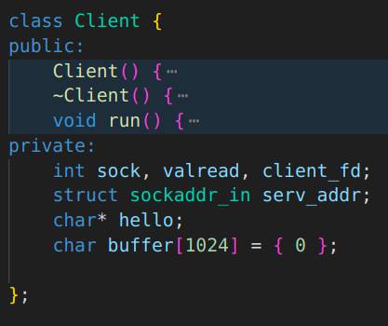
Code Structure
1. Server: 2. Client
Server Class Structure
Client Class Structure

Slide 11
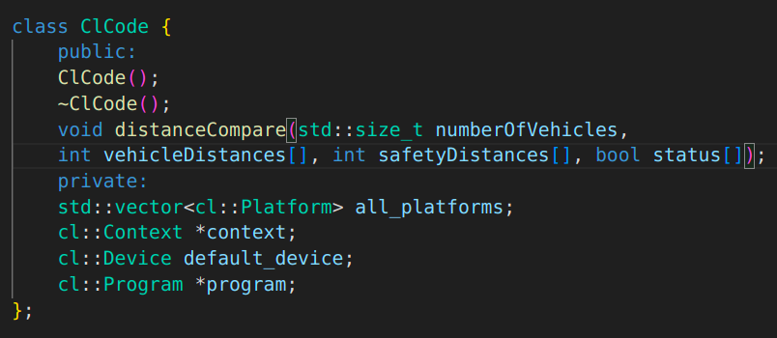
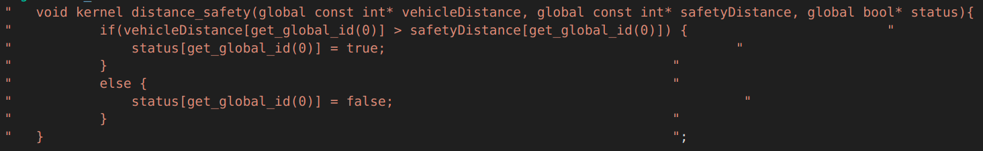
Code Structure
3.ClCode Code
4. Kernel Code
ClCode Class Structure
Kernel to compare distance and safety distance

Slide 12
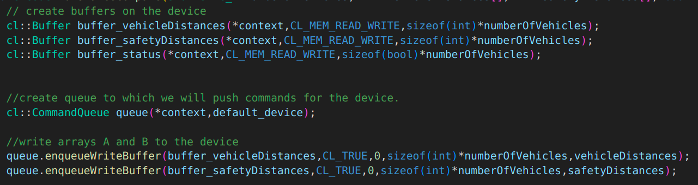
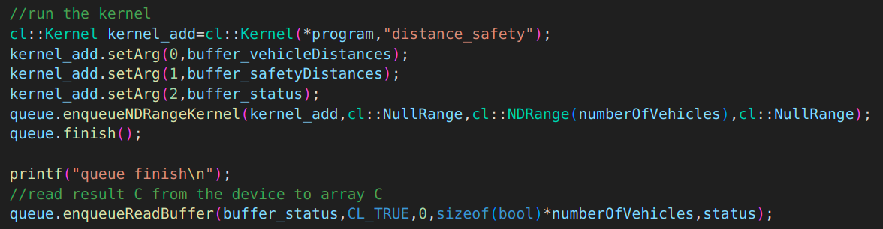
Code Structure
5.Buffer Creation and Data Writing
6. Adding arguments to kernel and execution
Buffer creation and data writing
Adding arguments to kernel and execution

Slide 13
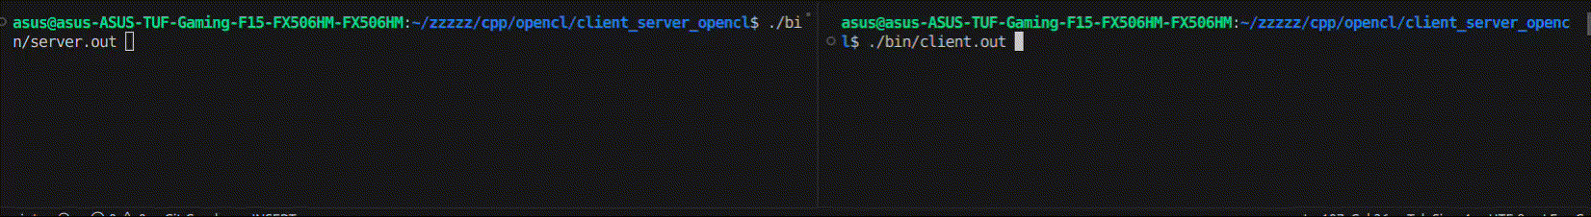
Code Execution
Client sends the data to the server
Server receives the data and then uses OpenCL for GPU
Server CLI
Client CLI

Slide 14
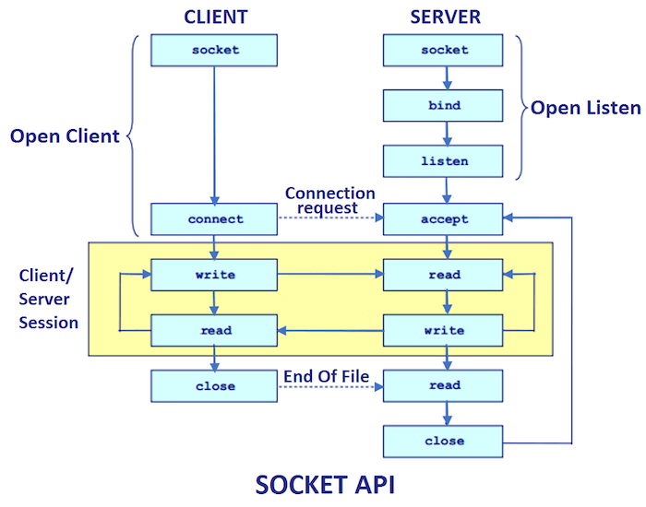
JAVA Implementation
Java programming is User Friendly
Advance Classes and Libraries to support new users
Has special classes for Socket programming(used in this implementation)
Socket programming is connection based in Java
Socket Classes have various inbuilt functions for connection
Tasks
Time in ms

Slide 15
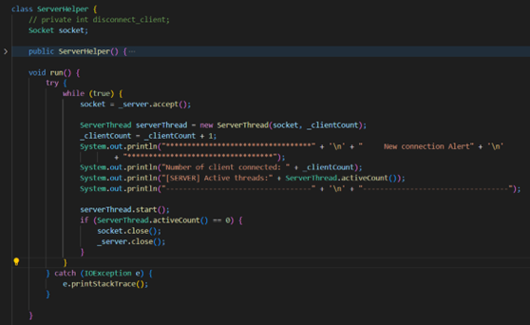
Details on Implementation 1
Implementation of the System is divided into:
Server – Main Vehicle
Client - Platoons
Server Implementation:
Connects with Platoon
Directs the Platoon
Handles all the calculations required
Class ServerHelper()

Slide 16
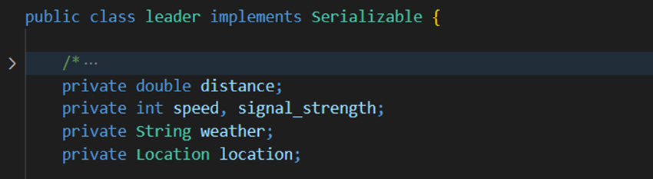
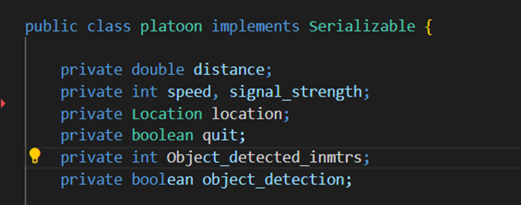
Details on Implementation 2
Individual classes for variable declaration
Main Vehicle has class leader() and Platoon has class platoon()
Class Leader
Class Platoon

Slide 17
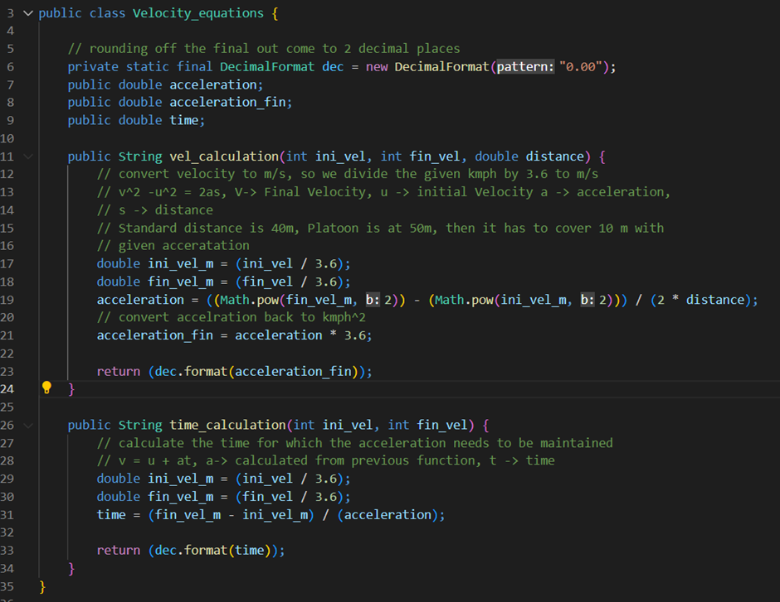
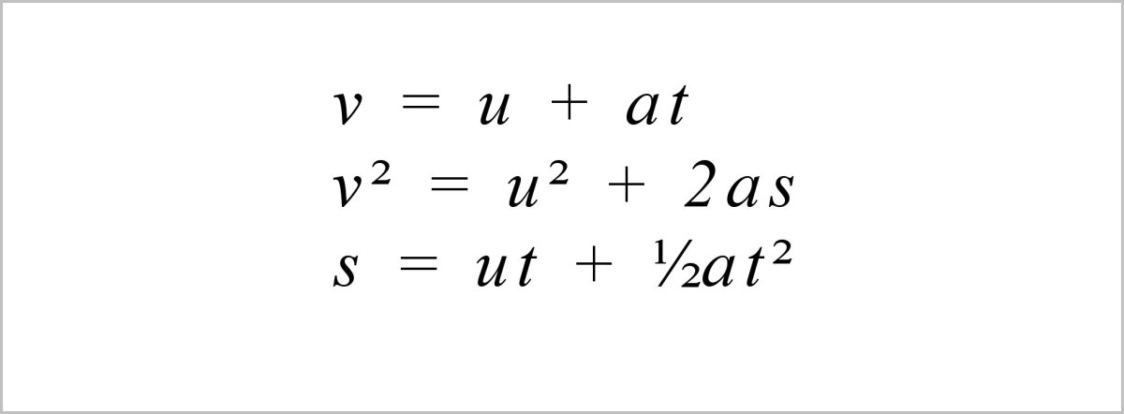
Details on Implementation 3
Server defines the characteristics of Main vehicle and is associated with multiple classes, they are:
Server
ServerThread
ServerHelper
Leader (All the variables required)
MonitorPlatooningData (Controls all variables distance, signal, etc)
Velocity_equations (Equations of motion)
Messages
Class Velocity_equations
Fig: Equations of Motion
Source: https://owlcation.com/stem/Solving-Projectile-Motion-Problems-Applying-Newtons-Equations-of-Motion-to-Ballistics

Slide 18
Details on Implementation 4
Client Implementation:
Allows to connect with the server
Constantly observes for obstacles
Provides parking spot under emergency situations
Implementation of Client:
Client defines the features associated with platoon, it interacts with following classes:
client
platoon (All variables required)
Parking_space (Has list of parking spots for platoon to park)

Slide 19
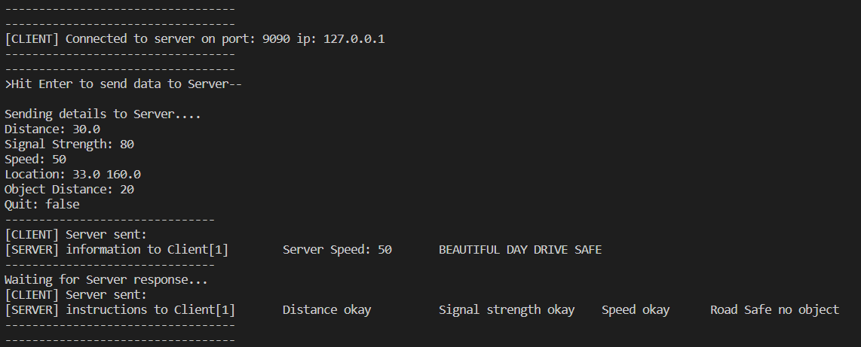
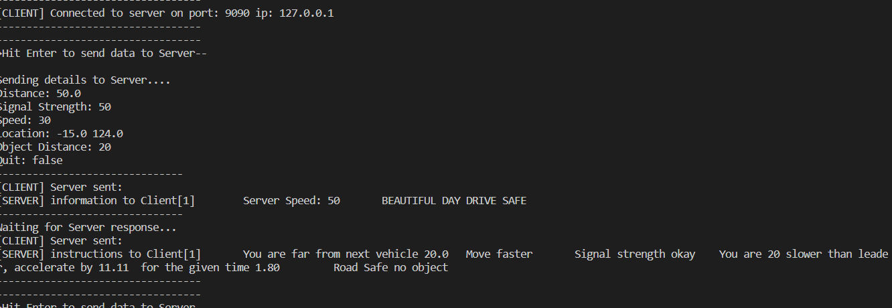
Results and Discussions
Output Normal conditions
Platoon slower than Leader
Distance to be maintained = 30units
Platoon distance = 30 units
Distance to be maintained = 30units
Platoon distance = 50 (speed up to cover 20 units)
Notes:
1. Normal Conditions: When the platoon is following the Main Vehicle and the values are maintained as per Main Vehicle, it acknowledges the platoon to continue in the same state. 2. Platoon slower than Leader : When the platoon is slower than the Leader vehicle, then the leader updates the platoon to increase the speed by giving it the exact values for acceleration and time

Slide 20
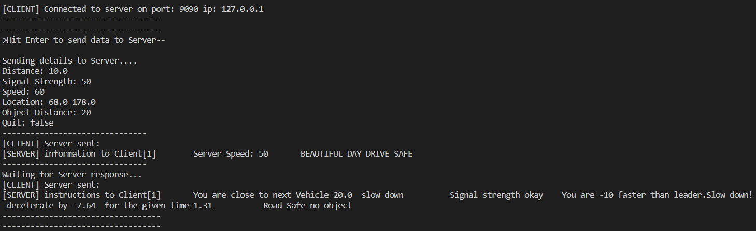
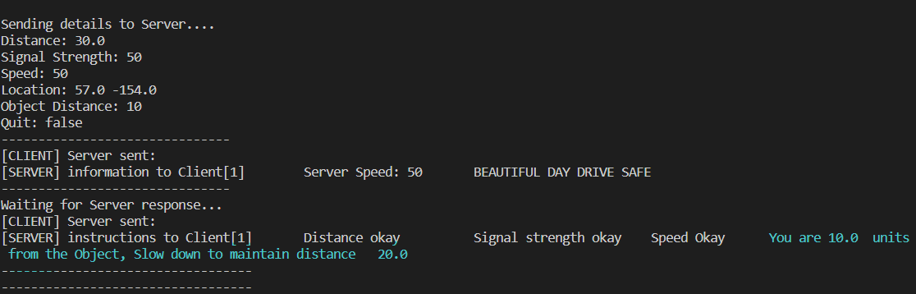
Results and Discussions
Platoon faster than Main Vehicle
Object detected
Distance to be maintained = 30units
Platoon distance = 10 units (Slow down to move 20 units farther)
Distance to be maintained = 30units
Platoon distance = 30 units
Object detected in = 10 units (Slow down to move 20units farther to make space for it
Notes:
3. Platoon faster than Leader : When the platoon is traveling at a higher speed and is approaching the next vehicle, the Main vehicle instructs it to slow down. 4. Object Detected: When Platoon updates the Main vehicle about object/external vehicle approaching the platoon, the Main vehicle instructs the Platoon to slow down and maintain the standard distance from the vehicle.

Slide 21
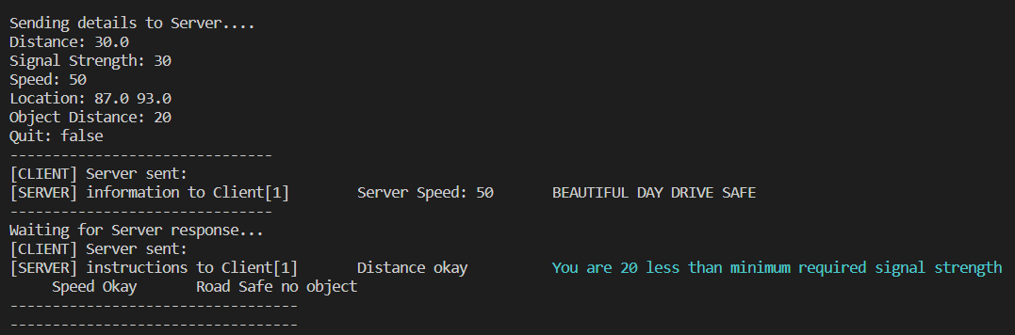
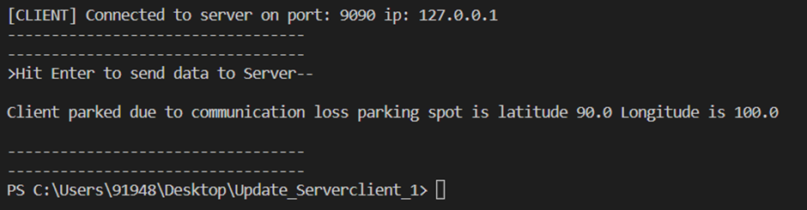
Results and Discussions
Signal Strength less than Leader expectation Std.
Platoon parked itself and updated the location
Signal strength to be maintained = 50units
Platoon’s signal strength = 30 units
Then platoon parks itself in the parking spot and sends the location details to server
Notes:
3. Platoon faster than Leader : When the platoon is traveling at a higher speed and is approaching the next vehicle, the Main vehicle instructs it to slow down. 4. Object Detected: When Platoon updates the Main vehicle about object/external vehicle approaching the platoon, the Main vehicle instructs the Platoon to slow down and maintain the standard distance from the vehicle.

Slide 22
Conclusion and Summary
The proposed system is successful in establishing the socket connections between one server socket and multiple client sockets using TCP protocol. The server socket a.k.a. Leader vehicle was able to monitor the following Platoons. The GPU programming was successfully implemented to monitor the speed of the platoons using OpenCL programming.
What is Platooning
Network Architecture and models
Socket Programming
GPU and JAVA implementation
Working Scenarios

Slide 23
Thank You

